Slide 1
Maximum Value From Your Pharmacy Benefits
Date or Subtitle
Client/Prospect name or logo here

Slide 2
Why is Pharmacy Benefit Management Needed?
Notes:
There is a disruption in the market place

Slide 3
Why Manage Pharmacy Benefits?
  Pharmacy costs have sky-rocketed over the past decade
    Older population
    Increased prevalence of some disease conditions
    Exponential number of new drugs available to common conditions and orphan conditions with no previous drug therapy
    Cost of new drugs is higher on average
    Drug price inflation
  …and is expected to continue double-digit growth well into the future
    Specialty trend average is 11%
    Overall trend average is 3%
Average cost per commercial member is now more than $1,000 annually

Slide 4
Historical perspective
Then
Now
Prescription Drugs
$51.3B in 1993
$335B in 2018
~35-40%
~87-90%
Generic
Dispensing Rate
Number of Specialty Drugs
<30
>400
Overall
Trend Growth
Double Digit
Single Digit / Flat

Slide 5
Cost Drivers
  Increases in trend are due to increases in utilization, not unit cost
  Specialty continues to be the main driver of overall spend
    New drugs are more expensive on average
    Drugs for conditions that previously had no medication available (orphan drugs)
  Decreases in Traditional drug were due to new generics
    Pregabalin (Lyrica)
    Tadalafil (Cialis)
Industry Trends in Drug Cost
11%
3%
Average 2019 Specialty Trend
Average 2019 Overall Trend
Notes:
Price inflation
Drug utilization
New drugs coming on the market
Patent cliff

Slide 6
Challenges
In the Industry
  Affordability
  Complex chronic diseases
  Political and regulatory environment
  Drug shortages
  Many PBMs not aligned to create savings for client/patient
  Holistic health models
For the Member
  Affordability
  Access to life-saving drugs
  Finding and understanding options
  Complex process to navigate
  Lack of tools and resources to improve their health
  Adherence to prescribed medications

Slide 7
What is a PBM?
What is a PBM?
Client Base
“Payors”
Contract Method
Insurance coverage for medication obtained at a pharmacy
  Does not include drugs dispensed during hospital stays, emergency room visits, or long-term care
  Employers
  Hospitals and Health Systems
  Government Agencies
  Union/Taft Hartley Funds
  Medicare Plans
  Medicaid Agencies
  ACA Exchange Plans
Roughly 40% of payors contract with PBMs through an administrator
Notes:
PHARMACY BENEFIT – insurance coverage for medication obtained at a pharmacy
Not drugs dispensed during hospital stays, emergency room visits, or injected/infused at physician’s office
Can be community pharmacies (e.g., Walgreens, CVS), mail order pharmacies, or specialty pharmacies
MANAGER – refers to “managed care” activities by PBM
Role of a PBM is to process claims, analyze trends network contracting and

Slide 8
PBM Services
Over the past 30 years, PBMs have evolved from claims processors to full-service benefit managers with integrated service models, supply chain access, and innovative technologies.
  Claims Adjudication
  Retail Pharmacy Network
  Mail Order Pharmacy
  Specialty Pharmacy
  Formulary Options
  Rebate Management
  Clinical Programs
  Financial Assistance
  Member Services
  Call Center
  Digital Tools (Portal, App, Text)
  Client Services
  Comprehensive Reporting
  Integration with medical and other benefit providers

Slide 9
Benefit Design Options
Cost Sharing
Formulary
Network
Copay, Coinsurance & Deductibles
Drug Tiering
Site of Care &
Exclusive Arrangements
Closed – only drugs on formulary are covered
Exclusive – drugs are organized as preferred and non-preferred with different cost sharing options
Open – non-formulary drugs are covered at some level
    Retail, Mail and Specialty Pharmacies
    Open Network – fill prescription at any pharmacy
    Narrow Network – limited network of pharmacies
    Closed Network – tightly controlled network with very few options
Notes:
Misconception is that one size fits all, when you work with us you can pick and chose, not only doing price assumptions but formulate a plan that fits your needs. Sometimes its pricing and sometimes its plan design.
COST SHARING – the amount members contribute to the cost of each prescription covered by their drug benefit.
TYPE OF COST-SHARING
Copayments - a proportion of the cost of a prescription
Coinsurance - percentage share of the cost
of a prescription
Deductibles - amount of out-of-pocket cost paid before the benefit coverage begins
NUMBER OF TIERS – examples can include:
Tier 1=generics (lowest copay)
Tier 2=preferred or formulary brands
Tier 3=nonpreferred or nonformulary brands
Tier 4=specialty medications (highest tier)
SITE OF SERVICE
Retail, mail order, and specialty pharmacies
FORMULARY – List of drugs covered by a plan
CLOSED FORMULARY – only drugs included on the formulary are included for reimbursement
EXCLUSIVE FORMULARY – drugs are classified for reimbursement by product type
OPEN FORMULARY – non-formulary drugs are covered at a define level in the benefit
Pharmacy Contracting and Credentialing
Verify that pharmacies that are qualified to provide the service
Auditing for fraud, waste and abuse and recredentialing are key to ensuring compliance
Types of Networks
Open Network – fill prescription at any pharmacy
Narrow Network – limited network of pharmacies
Closed Network – tightly controlled network with very few options
Analyses
Network Disruption – how many members may have to change pharmacies in a new network arrangement
Geo-access Report – how many members have an in-network pharmacy within a 2 mi, 5 mi, or 10 mi of their home
Many PBMs own or contract with a specific mail order pharmacy for maintenance medications
Many PBMs own or contract with a specific specialty pharmacy

Slide 10
Clinical Programs
  Formulary Management
  Drug Utilization Review
    Point of Sale Alerts
    Age & Gender Edits
    Retrospective Analysis
  Prior Authorization
  Quantity Limits
  Compound Management
  Step Therapy
  Hyperinflationary Drugs
  Medication Adherence
  Medication Therapy Management
  Disease-focused Member Support
The cost of non-adherence and non-optimized drug therapy practices is estimated at more than $600B per year.
Notes:
Clinical programs are intended to help members keep adherent, some PBMS introduce clinical programs that are not very robust, our core industry leading clinical programs seeing dramatic impact on Rx spend. Where we show the greatest impact. We coordinate care between patients, pharmacy and member to achieve optimal impact
Non adherence leads to a patient returning to the physician for not feeling well at which point physician prescribes more expensive medication which still leads to non-adherence and more complex condition.
Example about rubber stamping Pas
Formulary Management
Monitoring FDA Pipeline, reviewing industry literature and ensuring that the formulary is current and meets best practices for clinical outcomes
Drug Utilization Review
Point of Sale DUR Alerts
• Duplicate therapy
• High dose alerts
• Drug-Drug Interactions
• Duplicate medication
• Drug-Disease Interactions
Age Edits
This service provides processing edits and clinical review to ensure that certain medications which are targeted or approved for use in only certain age populations are restricted to those age groups. Lists are subject to change and are provided upon request. Common drug classes included in our Age Edit Module include; acne, ADHD, and more.
Gender Edits
This includes processing edits and clinical reviews to ensure that certain medications, which are targeted or approved for use in only certain gender populations, are restricted to those genders. Lists are subject to change and can be provided upon request. Common drug classes include oral contraceptives, hormone replacement, erectile dysfunction, and more.
Quantity Limits
Quantity level limits reduce waste by leveraging prescribing limits based upon FDA-approved guidelines for maximum dosages and treatment durations.
Retrospective Drug Utilization Review
The Retrospective Drug Utilization Review is a program which alerts providers of potential issues related to medication use. The program evaluates claims and patient data against clinically sound, evidence-based criteria and provides targeted interventions for clinicians from clinicians.
Prior Authorization – Clinical
The prior authorization program includes medications which should require that certain clinical criteria be met prior to approval of the medication.
Compound Management
Our Compound Management program helps plan sponsors contain costs while maintaining access to quality care. We offer a streamlined claims adjudication process that leverages a comprehensive list of excluded compound ingredients, bulk chemicals and kits that are hyperinflated. When non-excluded formulations are prescribed, WellDyne requires each ingredient in a compound claim, along with its associated pricing, to be submitted for review to determine the appropriateness of the final product.
Step Therapy
Step Therapy encourages members to try a preferred generic over a higher cost generic, often manufactured with the same active ingredient(s), or a higher cost brand, this program lowers drug spend without compromising quality of care.
Medication Adherence
Medication adherence program identifies barriers to compliance/non-compliance and works with patients and providers to improve overall medication compliance in targeted, chronic conditions where medication adherence is a common issue, and conditions significantly improved with better medication compliance. Target chronic conditions in diabetes, high blood pressure, high cholesterol, coronary artery disease and congestive heart failure.
Hyperinflationary Drugs
Hyperinflationary Drugs program monitors the pricing and clinical relevance of new and existing medications. Drugs are added to an exclusion list if they meet one or more of the following criteria:
• New dosage formulations that fail to demonstrate improved clinical outcomes fall into this category
• The medication is a combination product in which the active ingredients can be purchased separately at more than a 50% cost savings
• Cost is more than 2 times higher than other medications with similar therapeutic outcomes
Medication Therapy Management
Medication Therapy Management program is designed to optimize the benefits of medications for individual patients. Unlike other care programs that may focus on a single disease or problem, the MTM program is a comprehensive evaluation of all conditions and therapies a member may have.

Slide 11
The costs of medication non-adherence
125K+
$600B+
Poor Medication Adherence
Deaths occur annually
(Non-adherence is the 4th leading cause of death in the U.S.)
From non-adherence and non-optimized drug therapy per year
Increased Healthcare Costs
Poor Health Outcomes
20-30%
50%
Of medications are never filled
Of medications are
not taken as prescribed
Increased Healthcare Services
(ER visits, hospitalizations, etc.)
Source: https://blog.cureatr.com/what-does-patient-non-adherence-to-medication-really-cost

Slide 12
Drug Types
  Most PBMs use Medi-Span as the source for defining each drug’s type.
Generic
Brand
Specialty
Biosimilar
  Chemically equivalent copy designed from a brand-name drug where the patent has expired
  SINGLE-SOURCE GENERIC: A generic version of a brand drug produced exclusively by one manufacturer
  MULTI-SOURCE GENERIC: A generic version of a brand drug produced by more than one manufacturer
  A drug that has a trademark and is or previously was protected by a patent
  SINGLE-SOURCE BRAND: A drug manufactured by one company or source
  MULTI-SOURCE BRAND: A drug manufactured by more than one company or source
  A drug manufactured through biologic processes to treat chronic, complex, or life-threatening conditions
  A drug manufactured through biologic processes as well that are highly similar to another specialty drug
Notes:
Important you align with a PBM who understands the moving parts is acting in your clients best interest
Lot of moving parts, the hot ones driving cost is the specialty, but additionally we look at generics and brand to make sure patients are getting the right medication at the right time. Hyperinflationary, sometimes generics cost more than brand, we roll back the covers and identify where the cost saving opportunities are and we help you manage that.

Slide 13
Specialty: A complex, high-cost challenge
  Average Annual Drug Costs¹
Ten therapeutic categories are driving
Specialty is now
50%
87%
of total drug spend²
(60% expected in 2020)
of total specialty spend³
11%
65%
National average specialty trend
New drug launches will
be specialty therapies⁴
(projected between 2019-2023)
Radar on Specialty Pharmacy. February 2020. Volume 17, Number 2
Prime Therapeutics. The Inevitable Increase in Specialty Growth. November 14, 2017. Accessed October 1, 2018.
Artemetrx. 2019 State of Specialty Spend and Trend Report, 2018 Results. Published October 2019
IQVIA. The Global Use of Medicine in 2019 and Outlook to 2023. Published January 29, 2019
Notes:
Only 2 categories (auto-immune and oncology) are the key drivers of growth.

Slide 14
The Value of WellDyne

Slide 15
A proven approach with consistent results
Better
Care
Better Engagement
Better
Cost
94%
Overall specialty adherence
51%
Engagement with WellConnect Messages
6.4%
Specialty Trend
67%
Prior authorization approval rate
75%
Patients with First Fill Consult
15%
Therapy cost reduction due to WellAssist
76
Net Promoter Score
>90%
Patients opt in to
WellManaged programs​
25%
Reduction in Medical Specialty Spend
Notes:
Key Takeaway: Specialty patients are dealing with complex conditions that require special handling and support. We believe that providing better care allows for better engagement which ultimately results in better costs.

Slide 16
Our commitment: a collaborative partnership
Regular Meeting Cadence
Program enhancements
Annual enrollment support
Ongoing analysis,
feedback, planning
Operating Excellence
Exceptional implementation
Confirmation of “intent”
Detailed QA process
Tuning Plan Performance
Analytics and clinical insights
Plan performance reviews
Consult on trends and
spend management
Member Satisfaction
Go-live command center
Issue escalation & resolution
Day-to-day responsiveness

Slide 17


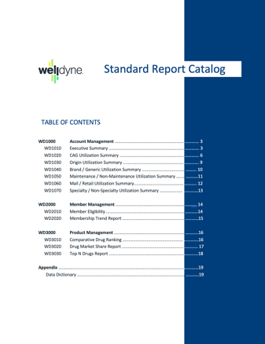
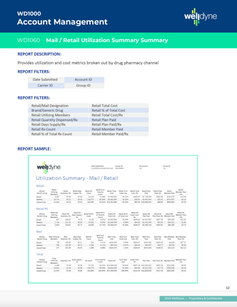
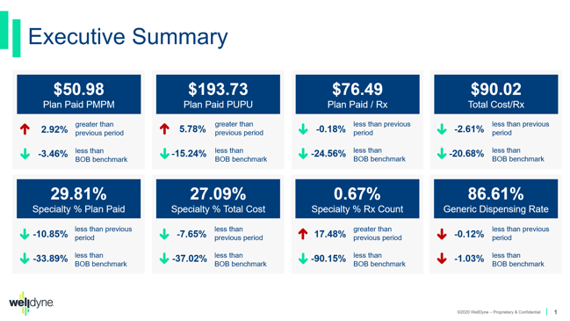
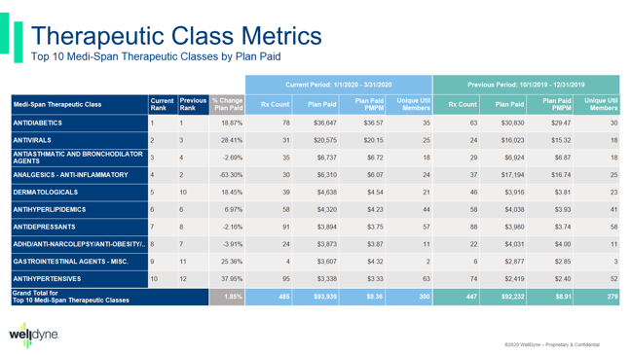
We provide comprehensive reporting
  Client Reporting
  Defined set of standard reports
  Multiple views via client, account or group
  Report catalog describes filtering options, provides sample reports and includes a detailed data dictionary
  Plan Reviews
  Highlights pharmacy trends and provides recommendations on:
    Plan design
    Clinical programs
    Utilization trends
    New drugs to market

Slide 18
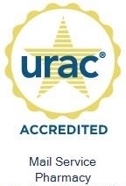
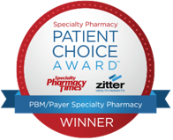

All the services you need from one PBM partner
Specialty Pharmacy
  Less than 2% of members are driving more than 50% of plan costs – we take great care of these patients
Mail Order Pharmacy
  Today, more than ever, consumers appreciate the convenience of home delivery for their medications
Clinical Programs
  Helping to make sure members get the right drug at the best possible cost
Member Services
  Helping members get the most value from their pharmacy benefits
PBM Services
Mail Order Pharmacy
Specialty Pharmacy
Clinical Programs
Member Services

